Slide 1
Universal Serial Bus
Dr. Joonwan Kim

Slide 2
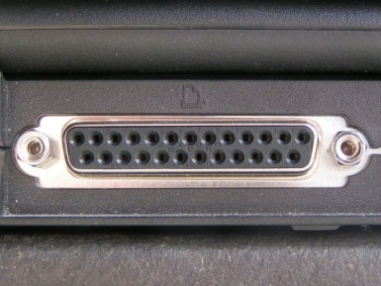
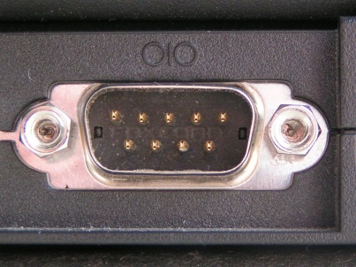
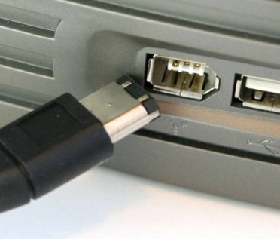
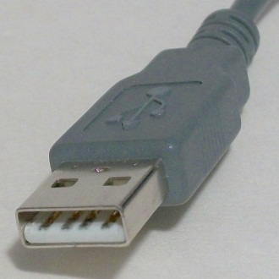
Why should we care?
Compare speeds of popular connections:
Parallel Port: 24 Mbit/s
Serial Port: 115 kbit/s
IEEE 1394 Firewire: 400 Mbit/s
USB version 1.1: 12 Mbit/s
USB version 2.0: 480 Mbit/s
USB version 3.0: 5 Gbit/s
COMING SOON!
Notes:
The USB plug shown is a type-A plug. Other types exist and have different shapes and sizes, but they are identical from a programming point of view.

Slide 3
What is USB?
It’s Universal Serial Bus.
  It allows a wide variety of devices to be connected with standardized physical and software connections.
  It can handle multiple data-transmission rates on one network.
  It also distributes power to connected devices.
Most new operating systems have USB capability.

Slide 4
What is USB?
USB was introduced in 1995.
The first widely-used standard, USB 1.1, was introduced in 1998 by IBM, Microsoft, Compaq, and others.
  It has two data rates, 12 Mb/s and 1.5 Mb/s.
  These two rates allow different-speed devices to be connected to the same computer.
USB 2.0 appeared in 2002 with a data rate of 480 Mb/s.
The USB 3.0 specification was released in 2008.

Slide 5
USB Developers’ Site
Go to http://www.usb.org/developers/!
USB 2.0 Specification
USB 3.0 Specification
UHCI (Universal Host Controller Interface) and EHCI (Enhanced HCI) specifications (more on these later)
And more!

Slide 6
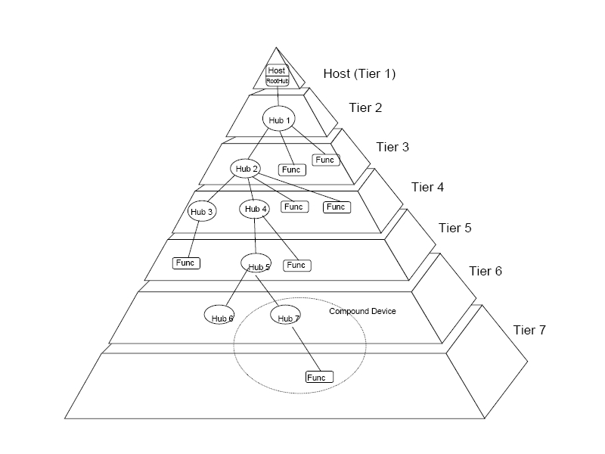
USB Network Structure
A USB system has a “tiered star” (tree) topology with the “host controller” at the root.
Up to 7 tiers
Branches end
with “functions”
(mice, joysticks,
etc.).
Hubs connect
branches.
A “compound
device” has
hub(s) and
function(s).
Notes:
The limit of seven levels comes from propagation time. Because all nodes on the seventh level must be leaf nodes and because the root must be the only node at level 1, only five levels of non-root hubs are possible.
Leaf nodes are “functions,” and include devices such as joysticks. Interior nodes are “hubs,” which should be self-explanatory.

Slide 7
USB Network Structure
Host controllers, the root device, are part of the host computer’s hardware and/or software.
The host controller initiates all communication and runs the network.
One host controller can manage up to 127 devices, including hubs.

Slide 8
Device Classes
USB devices are members of classes:
  human interface device
  mass storage device
  printer
  imaging device
  hub
Custom devices with custom (proprietary) drivers are also possible.
Notes:
A USB mouse is a human interface device. A USB Flash drive is a mass storage device.

Slide 9
Programming Model
Anything can be a host controller as long as it implements the Host Controller Device (HCD) specification.
Examples:
  UHCI: Intel’s creation, licensed by them to other vendors
  EHCI: Extended high-speed interface, USB 2.0 specification only

Slide 10
Device Communication
Each device has a unique address assigned to it by the host controller.
Each device has “endpoints” through which it communicates with the host controller.
“Pipes” connect endpoints.
  A pipe is a creation of the software, not a physical entity.
  A pipe acts as a dedicated network connection between endpoints, much like a telephone line.
Notes:
In addition to what’s on the slide, a USB cable has four wires: VCC, GND, and two data wires.

Slide 11
Device Communication
The pipes are categorized based on transfer type:
  Control transfers: bus management and status updates; typically pipe 0.
  Interrupt transfers: low latency, low data applications (ex: mice, keyboards).
  Bulk transfers: large data, all remaining bandwidth possible (file transfers).
  Isochronous transfers: guaranteed data speed for media; data loss is possible.
Notes:
- The number of pipes available to a device depends on the USB standard that it uses. USB 2.0, for example, allows up to 16 one-way pipes from the host controller to each device and up to 16 one-way pipes from each device to the host controller.
- Each endpoint on a device has a number. Endpoint 0 is always a reserved endpoint for control functions.

Slide 12
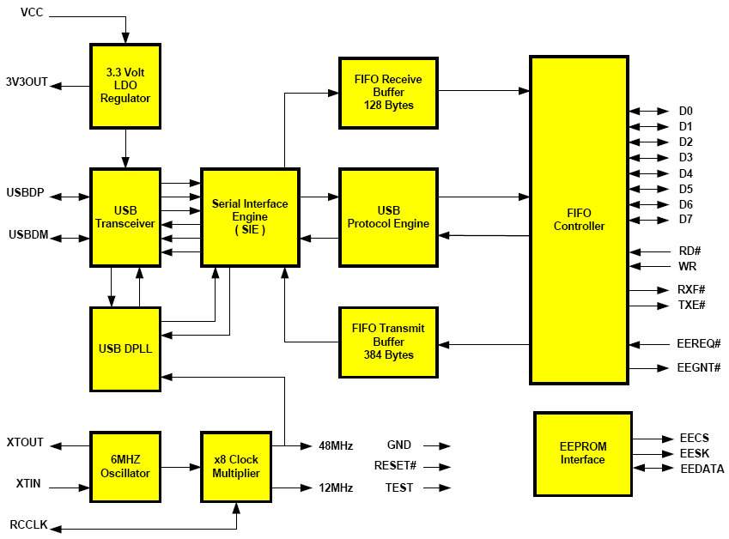
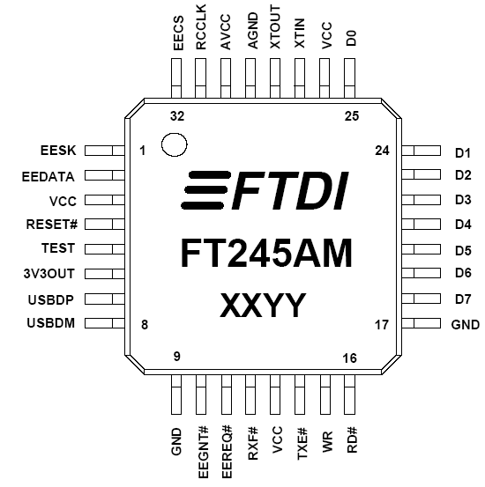
Interfacing with USB
FTDI
FT245AM

Slide 13

Pin Problems
USB chips typically come in non-DIP packages, such as the QFP-package FT8U245AM.
I found no DIP packages available.

Slide 14
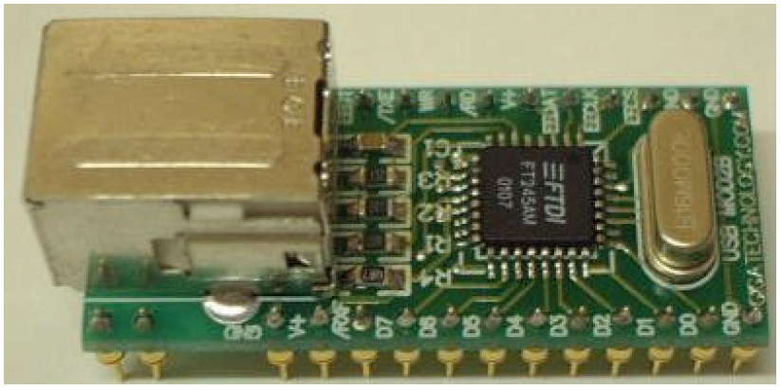
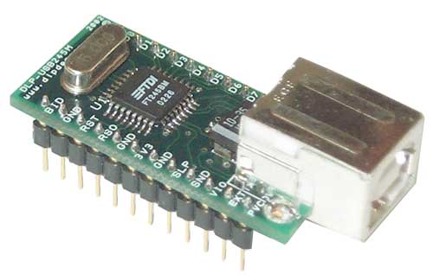
Examples of Common Adapters
USBMod2: FTDI 245BM Controller (Elexol)
DLP-USB245M
USB Adapter
(DLP Design)

Slide 15
USBMod2 Specs
USB 1.1 compliant: up to 1Mb/sec
32 pin DIP package
Everything, including 6MHz crystal, is integrated on the mini circuit-board
8 bit parallel interface to read/write
384 byte receive/128 byte transmit data buffer for faster transfers
Includes virtual COM drivers for Windows software interfacing

Slide 16
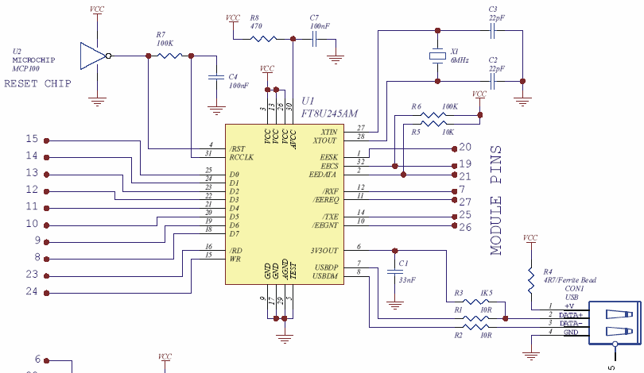
What’s on the USBMod2?
Full datasheet at http://www.dlpdesign.com/usb/dlp-usb245m12.pdf

Slide 17
DLP-USB245M Specs
USB 1.1 and 2.0 device compatible
U/E/OHCI Host Controller compatible
8 bit data bus (like USBMod2)
Uses FTDI Virtual COM port driver
Allows Bulk/Isochronous transfer

Slide 18
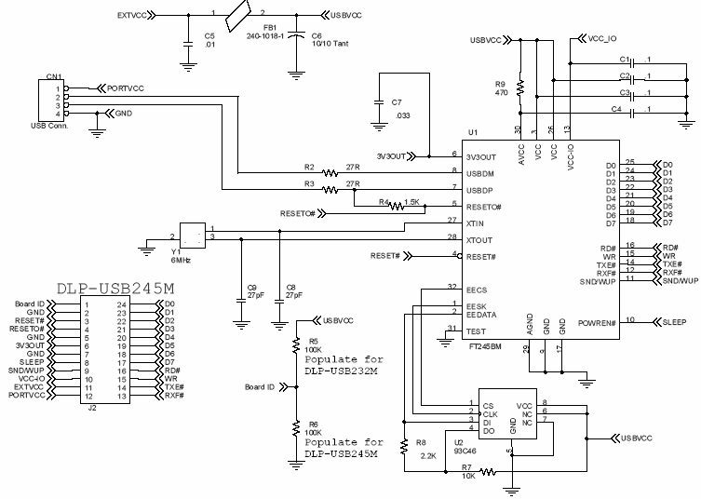
What’s on the DLP-USB245M?

Slide 19
USB
Advantages:
  Speed
    It’s faster than parallel or serial.
  Easy set-up
    Plug any device in and the host controller and hubs will do the rest.
Disadvantage:
  Speed
    The 68000 can’t keep up with it.
    That’s why we won’t use it in this class!
Notes:
Dr. Kim says the 68000 can’t keep up with USB. I haven’t been able to look into this much myself.

Slide 20
Questions?

Slide 21
Sources
USB Web site: http://www.usb.org
USB 2.0 Specification (available at http://www.usb.org/developers/docs/)
USB 3.0 Specification (also available at http://www.usb.org/developers/docs/)
Intel: http://www.intel.com/technology/usb/index.htm
History of USB: http://www.ibm.com/developerworks/power/library/pa-spec7.html
Dr. Kim

Slide 22
Sources
Data sheets:
  http://www.nxp.com/documents/data_sheet/LPC2141_42_44_46_48.pdf
  http://datasheets.maxim-ic.com/en/ds/MAX3453E-MAX3456E.pdf
  http://www.ftdichip.com/Documents/DataSheets/ft245r09.pdf
  http://www.elexol.com/Download/documents/USBIO24Rds1.pdf

Slide 23
Sources
Images:
  Parallel Port: http://www.ladyada.net/make/digg/programinterface.html, accessed January 12, 2010
  Serial Port: http://www.ladyada.net/make/simreader/use.html, accessed January 12, 2010
  FireWire port: http://www.microsoft.com/windowsxp/using/setup/hwandprograms/installhw.mspx, accessed January 12, 2010
  USB Plug: Daniel Patten’s collection
  Network pyramid: USB Specification Revision 2.0, page 16 (figure 4-2)
  All other images are from (or modified copies of images from) the data sheets listed on the previous slide.

